Slide 1
Fluid simulation sandbox
Game Physics 2019 Mini Project
Renier Reichert
Jan van Bergen

Slide 2
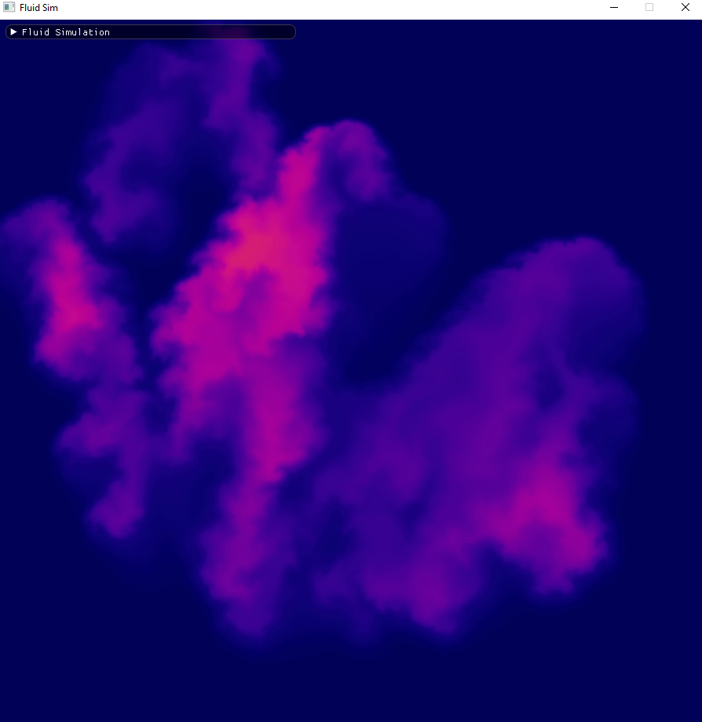
Based on Stable Fluids solver by Jos Stam
Semi-Lagrangian approach
We simulate:
Density
Temperature
Velocity
Allow users to play around with the fluid simulation in real time
OpenMP for parallelism

Slide 3

External forces
Gravity based on density
Buoyancy based on fluid temperature and room temperature
Kappa and Sigma are user parameters
$$f_{ext}=\left(−kd+σ\left(\frac{1}{T_{0}}−\frac{1}{T}\right)\right)\hat{j}$$

Slide 4
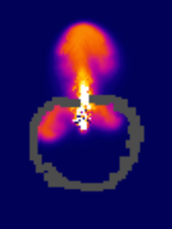
Internal boundaries
Original paper only supported edge boudaries
We have added internal boundaries
User can draw these

Slide 5

Vorticity confinement
Coarse grid
Low amount of iterations in the linear solver
Numerical dissipation causes high frequencies to dissolve
Additional force computed from curl
Force integrated using Forward Euler
$$ω=∇×\vec{v}$$
$$η =∇\left|ω\right|$$
$$Ψ=\frac{η}{\left|η\right|}$$
$$f =ε\left(ψ×ω\right)$$

Slide 6
Demo time

Slide 7
References
Real-Time Fluid Dynamics for Games - Jos Stam
Visual Simulation of Smoke - Ronald Fedkiw
GPU Gems Chapter 38 - Mark J. Harris
GPU Gems 3 Chapter 30 - Keenan Crane

